Slide 1
מונה/Timer
BLOCK DIAGRAM
Internal
Clock
מונה חלוקה
PR-#
TMR-#
Programmable Prescaler
Overflow
Interrupt
Flag
External
Clock
Input
Notes:
https://en.wikipedia.org/wiki/Prescaler

Slide 2
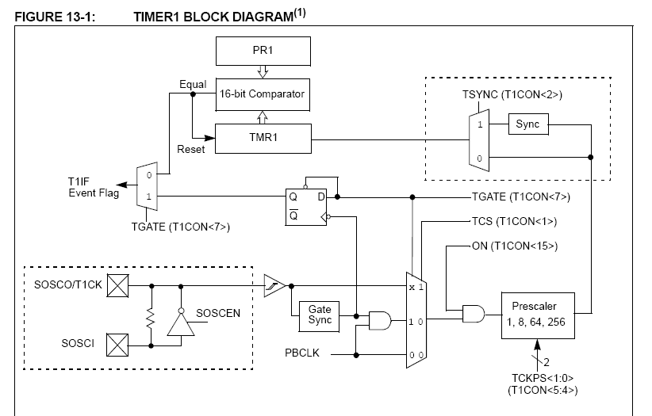

Slide 3
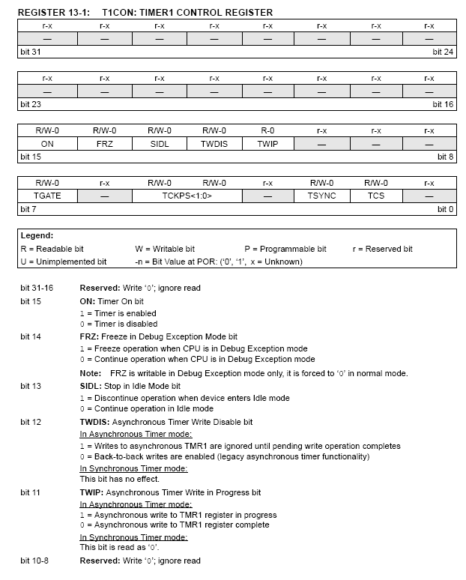

Slide 4
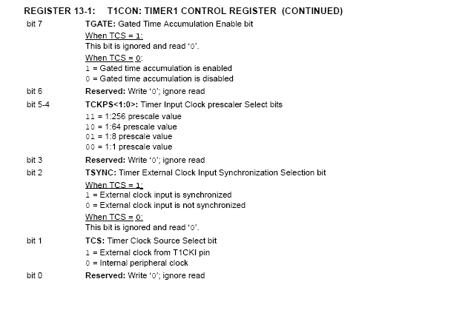

Slide 5
הפעלת TIMER1 כמונה השהייה 16bit
(פעילות LEDS)

Slide 6
#include "p32xxxx.h"
#pragma config FPLLMUL = MUL_20, FPLLIDIV = DIV_2, FPLLODIV = DIV_1, FWDTEN = OFF
#pragma config POSCMOD = HS, FNOSC = PRIPLL, FPBDIV = DIV_8
#define TRIS_MAIN_ADDR_DECODER {
unsigned int portfMap = TRISF;
portfMap &= 0xFFFFFEF8;TRISF=portfMap;
}
#define MAIN_ADDR_DECODER(CBA) PORTF = CBA
#define MAIN_DECODER_CS _RF8
#define TRIS_DATA_OUT{unsigned int porteMap = TRISE; porteMap &= 0xFFFFFF00; TRISE = porteMap;}
#define TRIS_LED_CLK {unsigned int portdMap = TRISD; portdMap &= 0xFFFFFFEF; TRISD = portdMap;}
#define LED_CLK _RD4
#define LED_EN 0x04
#define DISABLE 0x01
void delay(void);
#1

Slide 7
void main(void)
{
int x;
TRIS_MAIN_ADDR_DECODER
MAIN_DECODER_CS = DISABLE;
TRIS_DATA_OUT
TRIS_LED_CLK
LED_CLK = 0x0;
MAIN_ADDR_DECODER(LED_EN);
while(1)
{
PORTE = 0x55;
LED_CLK = 0x01;
LED_CLK = 0x00;
delay();
PORTE = 0xAA;
LED_CLK = 0x01;
LED_CLK = 0x00;
delay(); //for(d = 0;d < 80000;d++);
}
}
#2

Slide 8
void delay(void)
{
  T1CONbits.ON=0;
  T1CONbits.TGATE=0;
  T1CONbits.TCS=1;//in clock
  T1CONbits.TCKPS0=1;
  T1CONbits.TCKPS1=1;
  T1CONbits.TSYNC=1;
  TMR1=0;
  PR1=0X04FF;
  T1CONbits.ON=1;
  IFS0bits.T1IF=0;
  while(!IFS0bits.T1IF);
}
#3

Slide 9
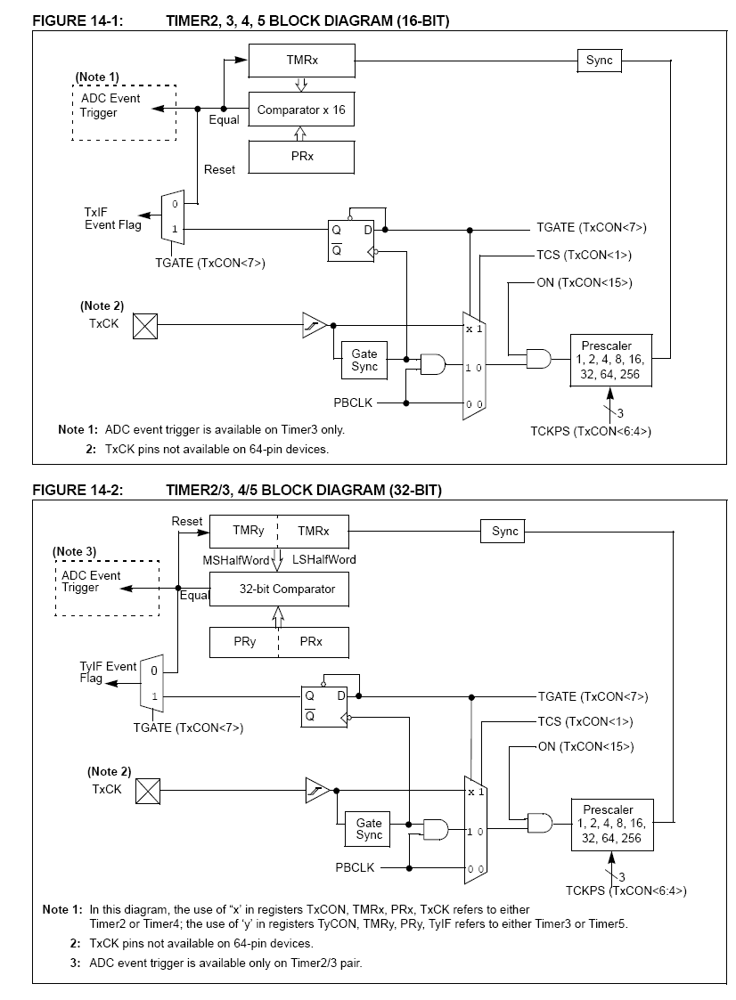

Slide 10
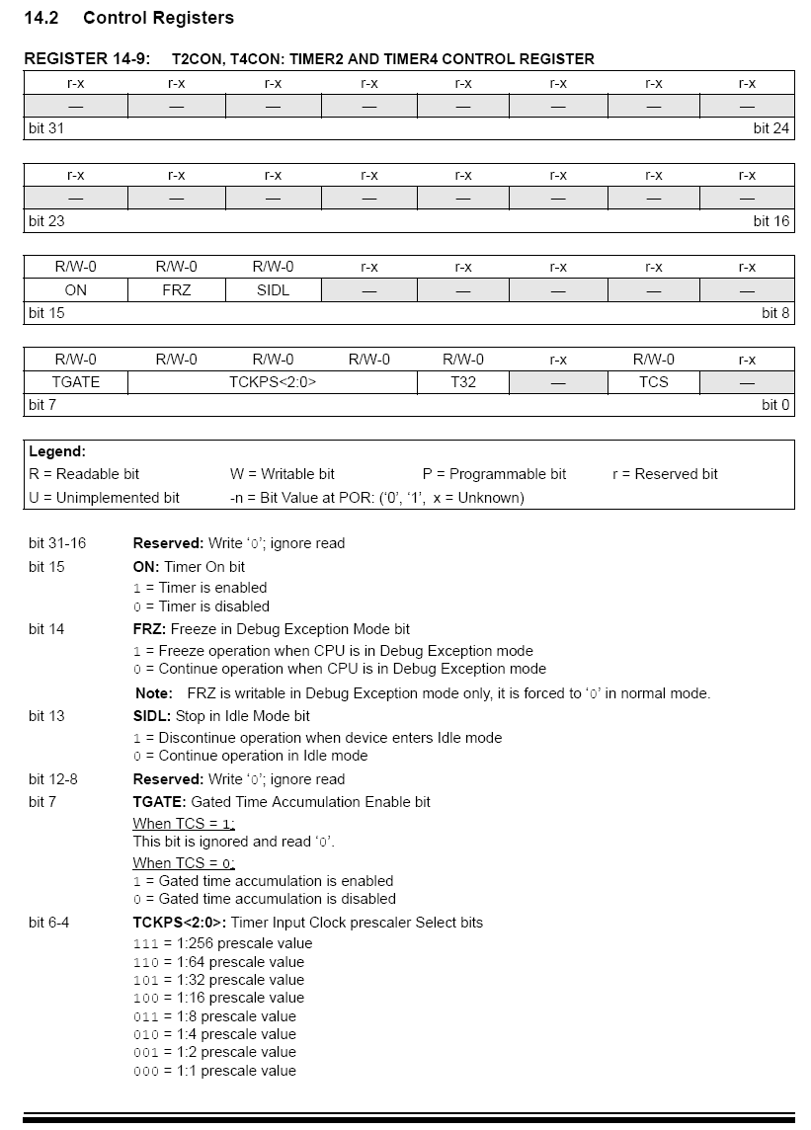
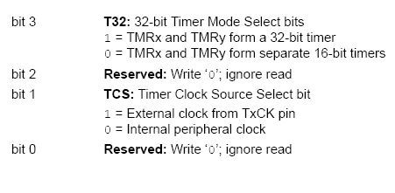

Slide 11
void delay(void)
{
  T2CONbits.ON=0;
  T2CONbits.TGATE=0;
  T2CONbits.TCS=0;
  T2CONbits.T32=1; // mode 32bit
  T2CONbits.TCKPS0=1; // חלוקה 256
  T2CONbits.TCKPS1=1;
  T2CONbits.TCKPS2=1;
  T3CONbits.ON=0;
  TMR3=0; // TMRy
  TMR2=0; // TMRx
  PR2=0X5000; // PR2x
  PR3=0; // PR2y
  T2CONbits.ON=1; // start timer
  IFS0bits.T2IF=0;
  IFS0bits.T3IF=0; //
  while(!IFS0bits.T3IF); // timer stop
}
הפעלת TIMER23 כמונה השהייה 32bit

